Slide 1
Partial Orderings

Slide 2
Introduction
An equivalence relation is a relation that is reflexive, symmetric, and transitive
A partial ordering (or partial order) is a relation that is reflexive, antisymmetric, and transitive
  Recall that antisymmetric means that if (a,b) ∈ R, then (b,a) ∉ R unless b = a
  Thus, (a,a) is allowed to be in R
  But since it’s reflexive, all possible (a,a) must be in R

Slide 3
Partially Ordered Set (POSET)
A relation R on a set S is called a partial ordering or partial order if it is reflexive, antisymmetric, and transitive. A set S together with a partial ordering R is called a partially ordered set, or poset, and is denoted by (S, R)

Slide 4
Example (1)
Let S = {1, 2, 3} and
let R = {(1,1), (2,2), (3,3), (1, 2), (3,1), (3,2)}
1
2
3

Slide 5


In a poset the notation a b denotes that
This notation is used because the “less than or equal to” relation is a paradigm for a partial ordering. (Note that the symbol is used to denote the relation in any poset, not just the “less than or equals” relation.) The notation a b denotes that
a b, but

Slide 6
Example
Let S = {1, 2, 3} and
let R = {(1,1), (2,2), (3,3), (1, 2), (3,1), (3,2)}
2 2
3 2
1
2
3

Slide 7
Example (2)
Show that ≥ is a partial order on the set of integers
  It is reflexive: a ≥ a for all a ∈ Z
  It is antisymmetric: if a ≥ b then the only way that
  b ≥ a is when b = a
  It is transitive: if a ≥ b and b ≥ c, then a ≥ c
Note that ≥ is the partial ordering on the set of integers
(Z, ≥) is the partially ordered set, or poset

Slide 8

Example (3)
Consider the power set of {a, b, c} and the subset relation. (P({a,b,c}), )
Draw a graph of this relation.

Slide 9
Comparable / Incomparable
The elements a and b of a poset (S, ) are called comparable if either a b or b a. When a and b are elements of S such that neither a b nor b a, a and b are called incomparable.

Slide 10
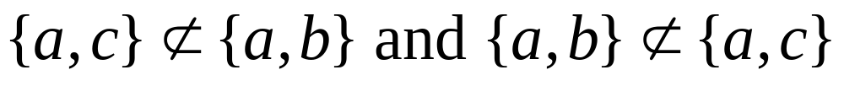
Example
Consider the power set of {a, b, c} and the subset relation. (P({a,b,c}), )
So, {a,c} and {a,b} are incomparable

Slide 11
Totally Ordered, Chains
(S, )
If is a poset and every two elements of S are comparable, S is called totally ordered or linearly ordered set, and is called a total order or a linear order. A totally ordered set is also called a chain.

Slide 12
In the poset (Z⁺,≤), are the integers 3 and 9 comparable?
  Yes, as 3 ≤ 9
Are 7 and 5 comparable?
  Yes, as 5 ≤ 7
As all pairs of elements in Z⁺ are comparable, the poset (Z⁺,≤) is a total order
  a.k.a. totally ordered poset, linear order, or chain

Slide 13
In the poset (Z⁺,|) with “divides” operator |, are the integers 3 and 9 comparable?
  Yes, as 3 | 9
Are 7 and 5 comparable?
  No, as 7 | 5 and 5 | 7
Thus, as there are pairs of elements in Z⁺ that are not comparable, the poset (Z⁺,|) is a partial order. It is not a chain.

Slide 14
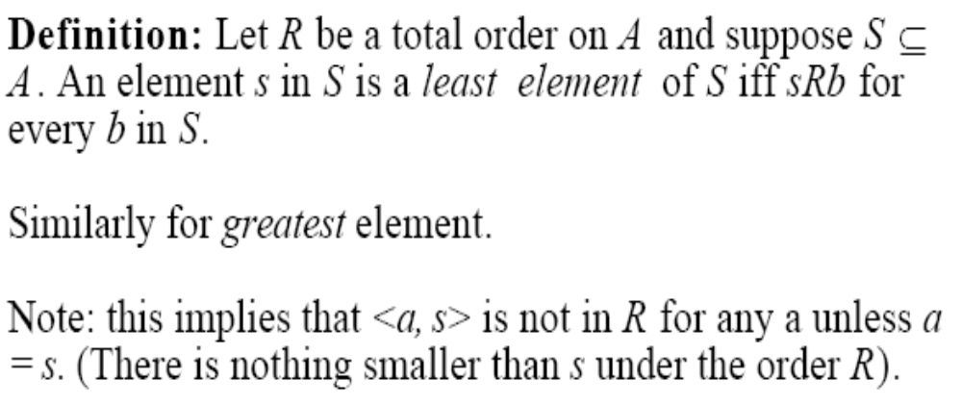

Slide 15
Well-Ordered Set
(S, )
is a well-ordered set if it is a poset such that is a total ordering and such that every nonempty subset of S has a least element.
Example: Consider the ordered pairs of positive integers, Z⁺ x Z⁺ where

Slide 16
Well-ordered sets examples
Example: (Z,≤)
  Is a total ordered poset (every element is comparable to every other element)
  It has no least element
  Thus, it is not a well-ordered set
Example: (S,≤) where S = { 1, 2, 3, 4, 5 }
  Is a total ordered poset (every element is comparable to every other element)
  Has a least element (1)
  Thus, it is a well-ordered set

Slide 17
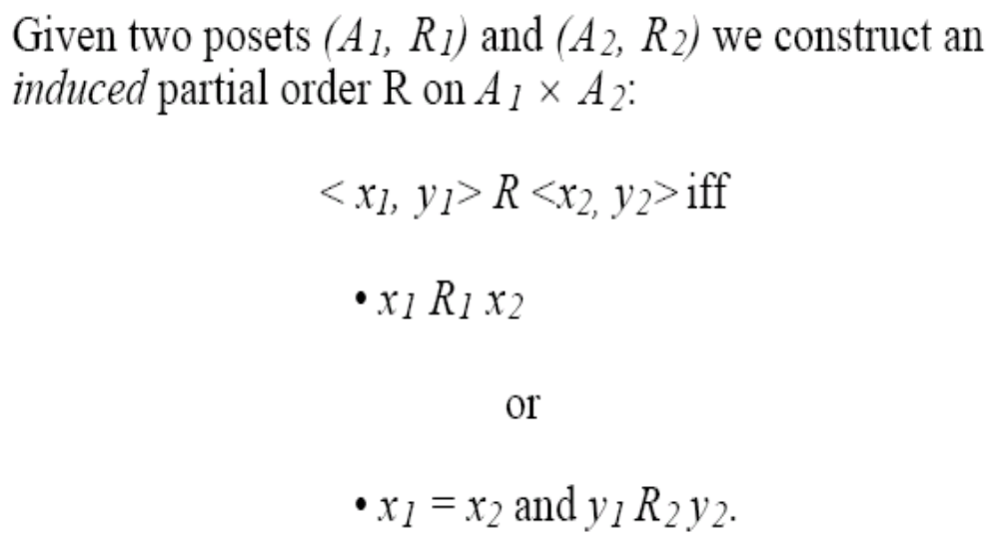
Lexicographic Order
This ordering is called lexicographic because it is the way that words are ordered in the dictionary.

Slide 18
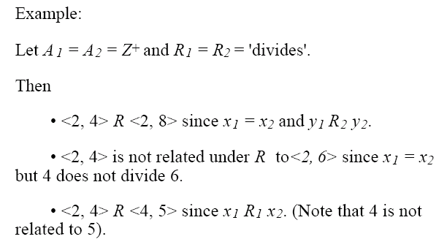

Slide 19



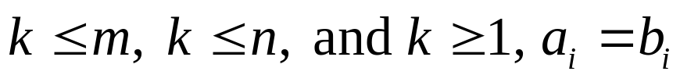


Let be a finite set and suppose R is a partial order relation defined on . Define a relation on , the set of all strings over , as follows:
For any positive integers m and n and a₁a₂…a_{m} and b₁b₂…b_{n} in .
If and a_{i} = b_{i} for all i = 1, 2, , . . ., m, then
a₁,a₂…a_{m} b₁b₂….b_{n}.
If for some integer k with
for all i = 1,2,…,k-1, and a_{k} R b_{k} but , then
a₁,a₂…a_{m} b₁b₂….b_{n}.
3. If is the null string and s is any string in
then s.

Slide 20

The Principle of Well-Ordered Induction
Suppose that S is a well-ordered set. Then P(x) is true for all x S, if:
BASIS STEP: P(x₀) is true for the least element of S, and
INDUCTION STEP: For every y S if P(x) is true for all x y, then P(y) is true.

Slide 21
Hasse Diagrams
Given any partial order relation defined on a finite set, it is possible to draw the directed graph so that all of these properties are satisfied.
This makes it possible to associate a somewhat simpler graph, called a Hasse diagram, with a partial order relation defined on a finite set.

Slide 22
Hasse Diagrams (continued)
Start with a directed graph of the relation in which all arrows point upward. Then eliminate:
the loops at all the vertices,
all arrows whose existence is implied by the transitive property,
the direction indicators on the arrows.

Slide 23
Example
Let A = {1, 2, 3, 9, 19} and consider the “divides” relation on A:
For all
18
9
2
3
1

Slide 24
Example
Eliminate the loops at all the vertices.
Eliminate all arrows whose existence is implied by the transitive property.
Eliminate the direction indicators on the arrows.
18
9
2
3
1

Slide 25
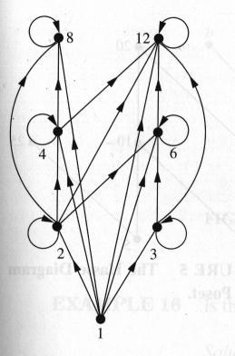
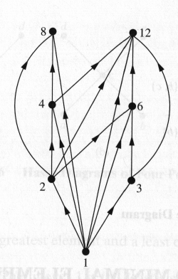
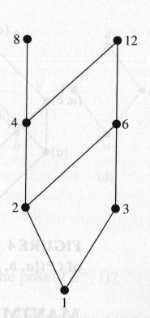
Hasse Diagram
For the poset ({1,2,3,4,6,8,12}, |)

Slide 26
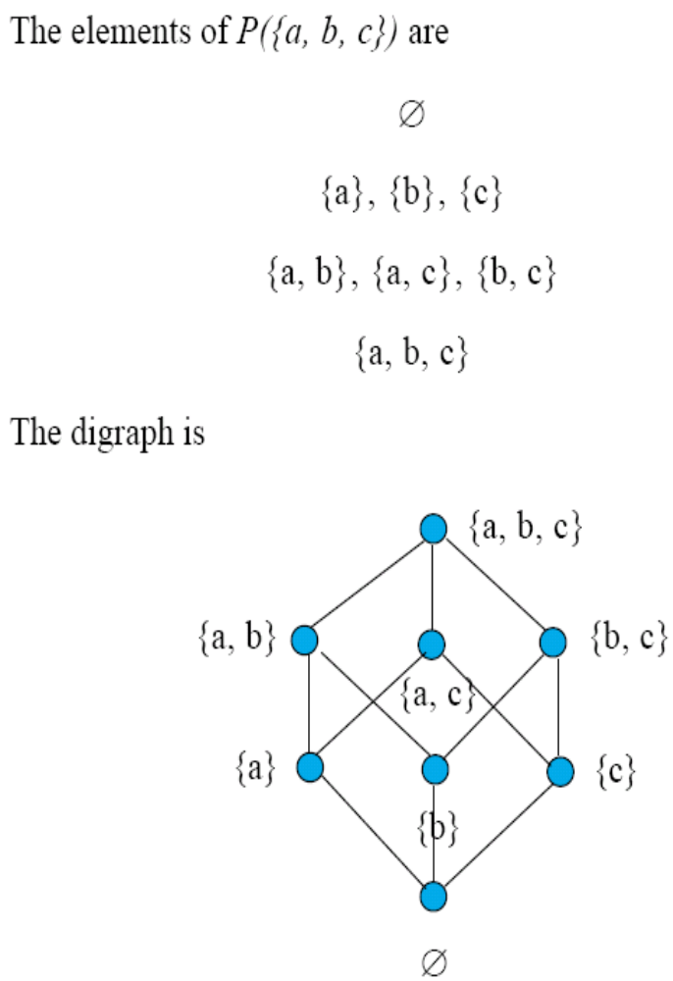

Slide 27
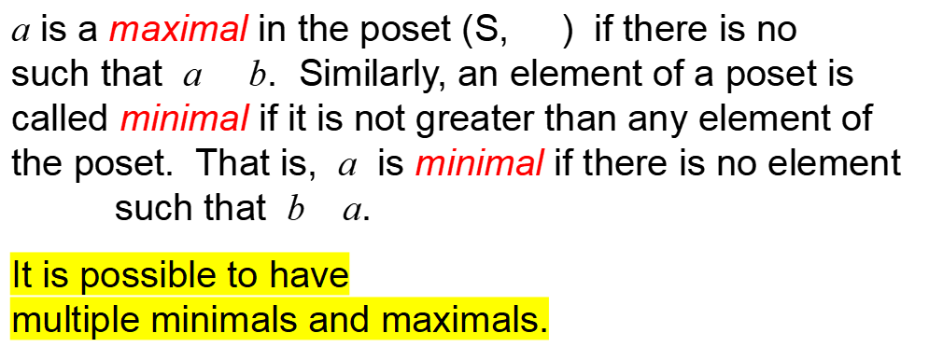


Maximal and Minimal Elements

Slide 28
Greatest Element
Least Element
a is the greatest element in the poset (S, ) if b a
for all . Similarly, an element of a poset is called the least element if it is less or equal than all other elements in the poset. That is, a is the least element if
a b for all

Slide 29

Upper bound, Lower bound
Sometimes it is possible to find an element that is greater than all the elements in a subset A of a poset (S, ). If u is an element of S such that a u for all elements , then u is called an upper bound of A. Likewise, there may be an element less than all the elements in A. If l is an element of S such that l a for all elements , then l is called a lower bound of A.
Examples 18, p. 574 in Rosen.

Slide 30
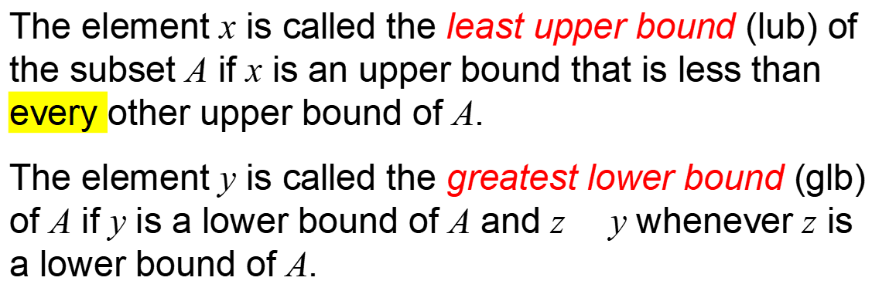
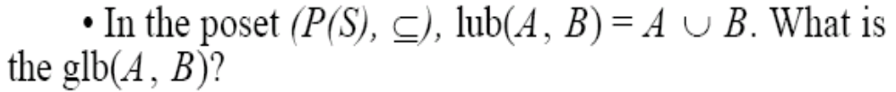
Least Upper Bound,
Greatest Lower Bound
Examples 19 and 20, p. 574 in Rosen.

Slide 31
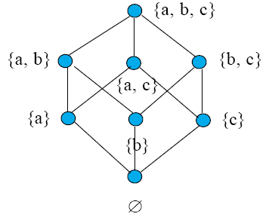

Lattices
A partially ordered set in which every pair of elements has both a least upper bound and a greatest lower bound is called a lattice.

Slide 32
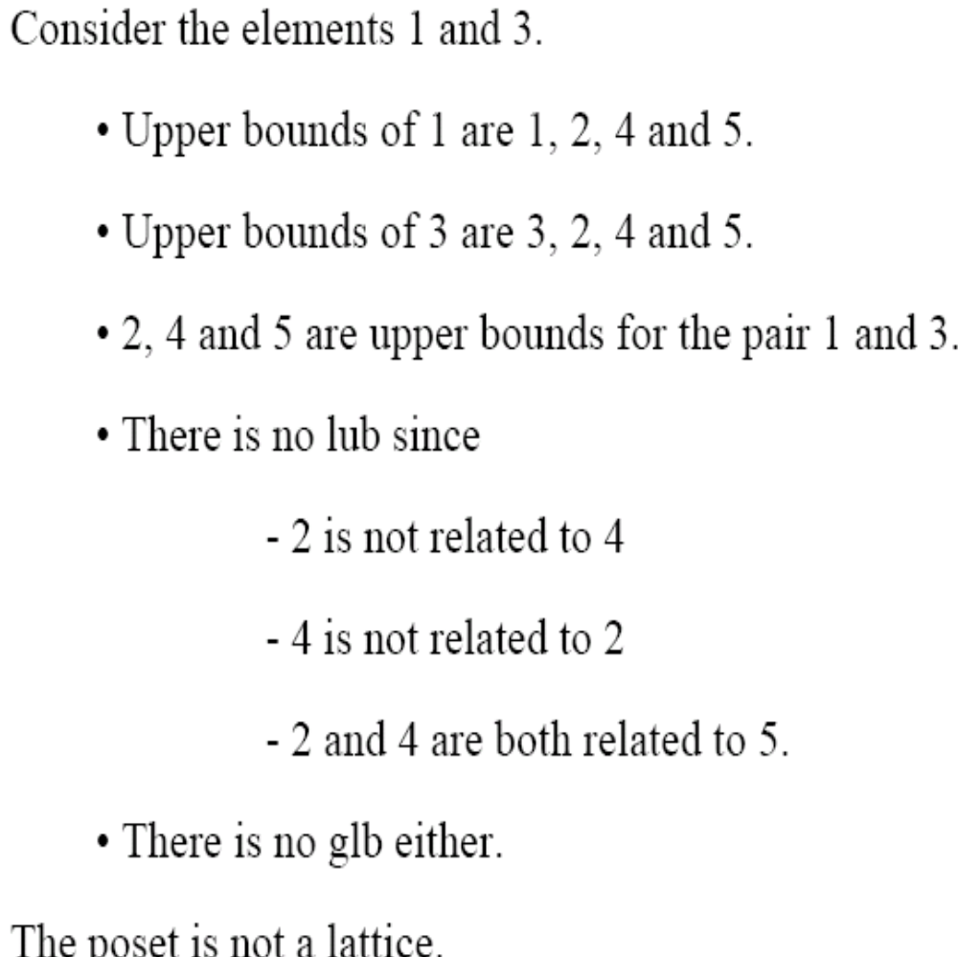
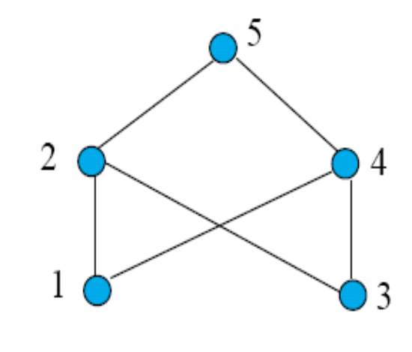
Examples 21 and 22, p. 575 in Rosen.

Slide 33
Lattice Model (LinuxSecurity.com)
(I) A security model for flow control in a system, based on the lattice that is formed by the finite security levels in a system and their partial ordering. [Denn] (See: flow control, security level, security model.) (C) The model describes the semantic structure formed by a finite set of security levels, such as those used in military organizations. (C) A lattice is a finite set together with a partial ordering on its elements such that for every pair of elements there is a least upper bound and a greatest lower bound. For example, a lattice is formed by a finite set S of security levels -- i.e., a set S of all ordered pairs (x, c), where x is one of a finite set X of hierarchically ordered classification levels (X1, ..., Xm), and c is a (possibly empty) subset of a finite set C of non-hierarchical categories (C1, ..., Cn) -- together with the "dominate" relation. (See: dominate.)

Slide 34
Topological Sorting
A total ordering is said to be compatible with the partial ordering R if
a b whenever a R b. Constructing a total ordering from a partial ordering is called topological sorting.

Slide 35
9
6
3
4
8
2
0
5
1
7
0
1
2
3
4
5
6
7
8
9
If there is an edge from v to w, then v precedes w in the sequential listing.

Slide 36

Example
Consider the set A = {2, 3, 4, 6, 18, 24} ordered by the “divides” relation. The Hasse diagram follows:
24
18
4
6
2
3
The ordinary “less than or equal to” relation on this set is a topological sorting for it since for positive integers a and b, if a|b then a b.

Slide 37
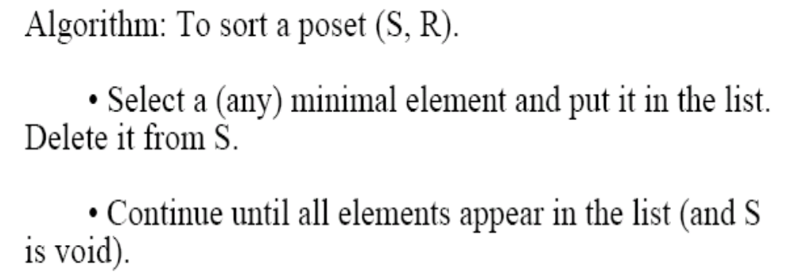
Topological Sorting

Slide 38
Assemble an Automobile
Build Frame
Install engine, power train components, gas tank.
Install brakes, wheels, tires.
Install dashboard, floor, seats.
Install electrical lines.
Install gas lines.
Attach body panels to frame
Paint body.

Slide 39
Prerequisites
Task | Immediately Preceding Tasks | Time Needed to Perform Task
1 2 3 4 5 6 7 8 9 | 1 1 2 2, 3 4 2, 3 4, 5 6, 7, 8 | 7 hours 6 hours 3 hours 6 hours 3 hours 1 hour 1 hour 2 hours 5 hours

Slide 40
Example – Job Scheduling
What is the total order compatible with it?
Task 4
6 hours
Task 6
1 hour
Task 2
6 hours
Task 1
7 hours
Task 5
3 hours
Task 3
3 hours
Task 9
5 hour
Task 8
2 hour
Task 7
1 hour

Slide 41
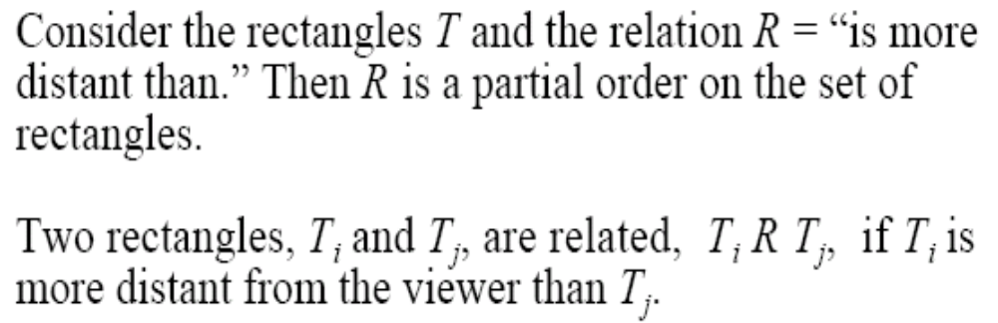
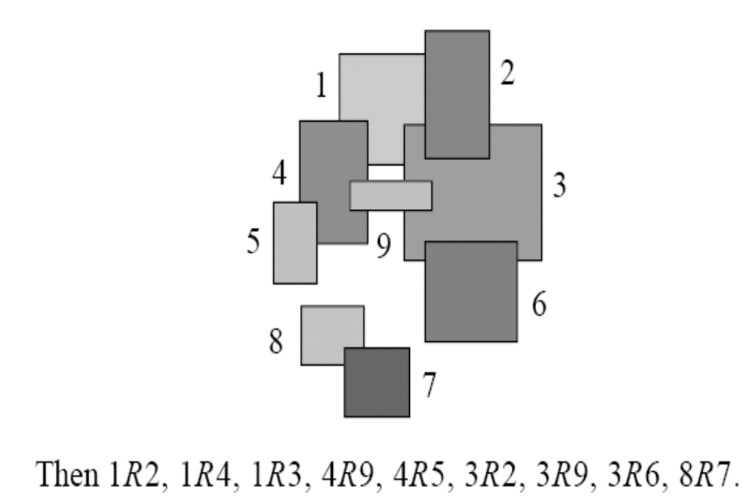

Slide 42
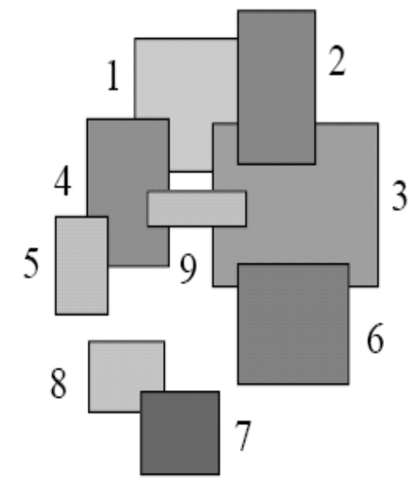
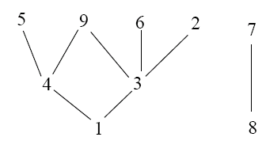
Example 27, p. 578 in Rosen.

